Slide 1
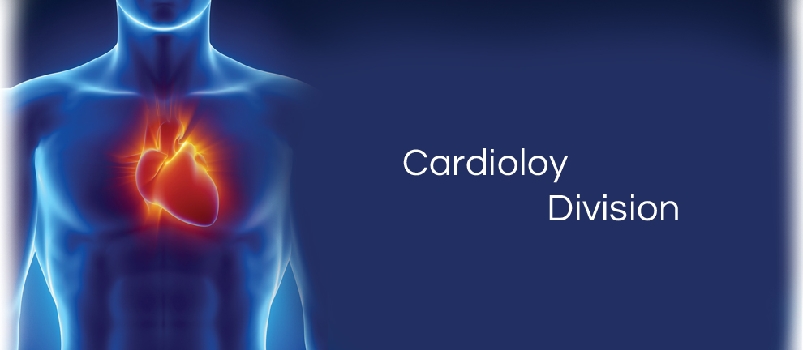
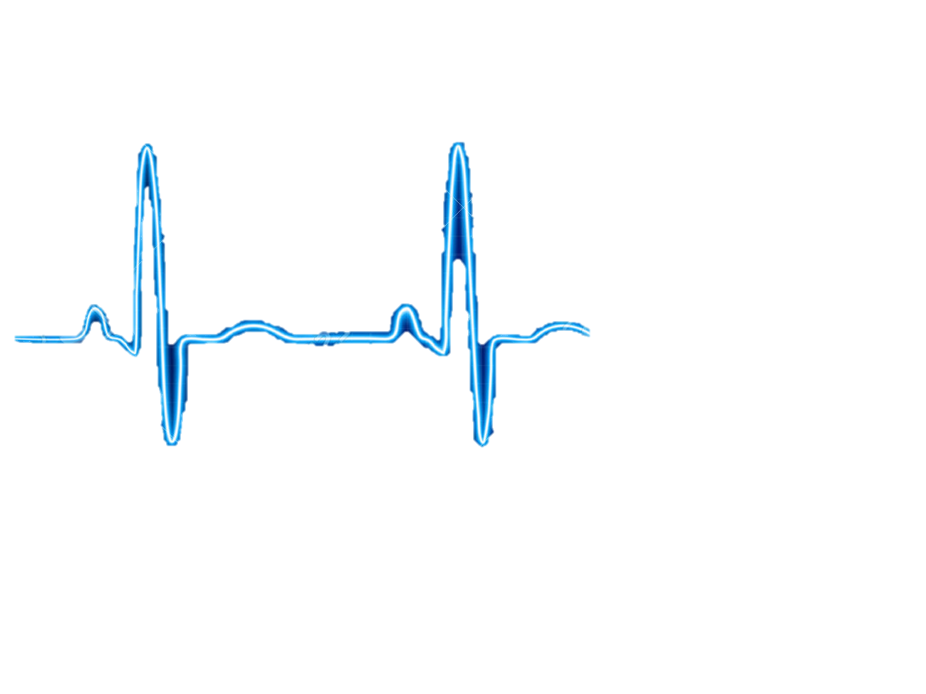
Prototype Check #2
Technical, scientific and customer oriented design evaluation
CARDIOVASCULAR TEAM
Qingbo Kang
Arthur Kohler
Chantelle Janeiro
Naghmeh Bandari
February 28th, 2018

Slide 2
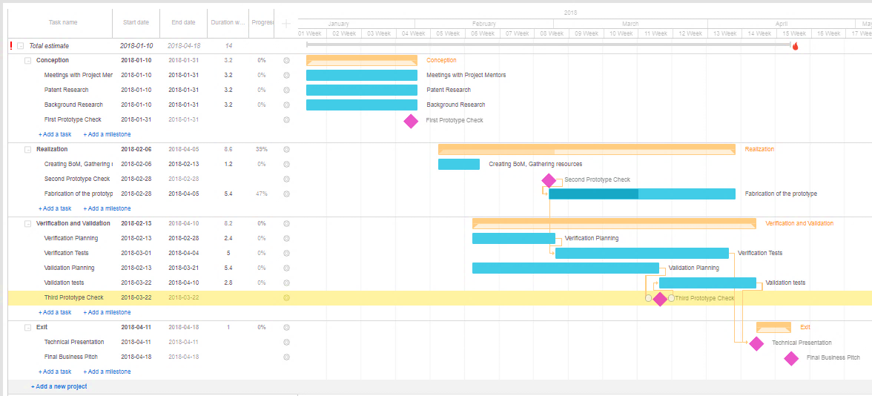
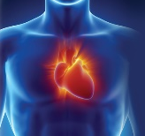
Prototype Management Plan
aaaa
bbb

Slide 3
Mechanical Design
“AnnuloFit”

Slide 4
Design and Components
=
+
+
+
Valvoluplasty
Balloon
Catheter Body
Optical Fiber
Light Sensor

Slide 5
Sensing Principle
Light Source
x
x
Multiple points
x
x
Continuous Sweep
Quarter Sweep
Optical Processing

Slide 6
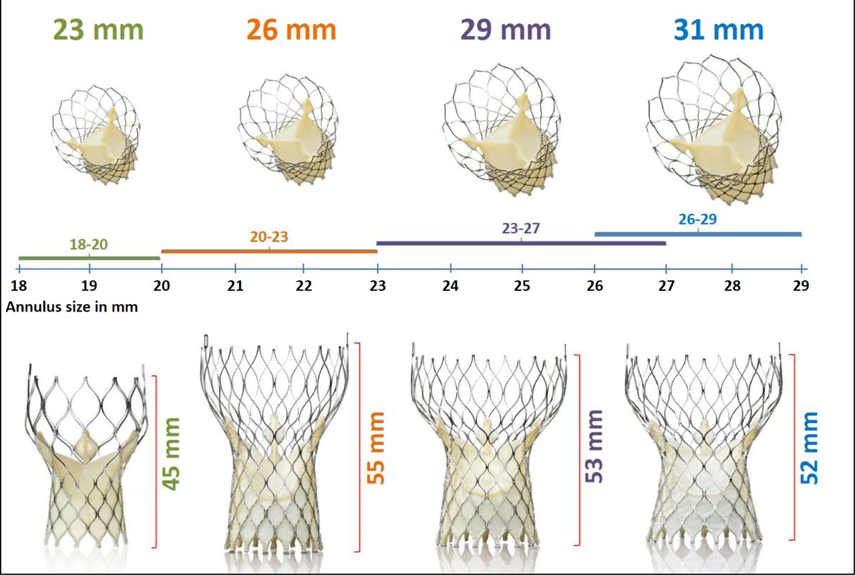
Performance indicators
Reflected Light Intensity
Annulus Diameter
Accuracy: 1mm
Repeatability: 95%
Medtronic Corevalve

Slide 7
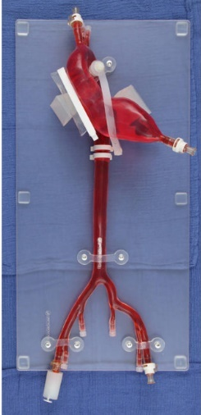
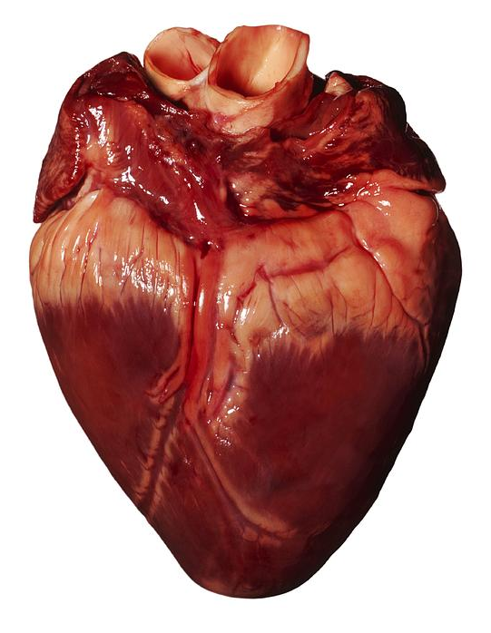
Concept Validation
Proof of concept: test the ability for a valvuloplasty balloon (attached to catheter) to occlude the left ventricle and stop the blood from temporarily flowing through the aorta.
Create a 3D print of the innovated balloon device.
Development of the balloon’s interior working channel, which will include a photodetector, rotational/translational mini-motor and single mode optical fibers
Test the ability of a 3D printed balloon to inflate and measure the diameter of a conical model.
Conduct an in vivo experiment to test whether the balloon is able to capture and detect proper valve sizes. These results will be compared with standard imaging practices, namely CT scans.
TAVR Transcatheter Model
Pig Heart
3D printed conical model
for calibration and validation

Slide 8
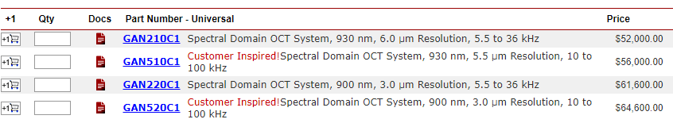
Accordance with customer/market needs
OCT Ganymede Series → hospitals will be unwilling to spend $50,000+ on the necessary OCT machinery

Slide 9
CARDIOVASCULAR TEAM
Thank You…

